Slide 1
Capstone of Fall 2022
Jiaqi (Jackie) Min

Slide 2
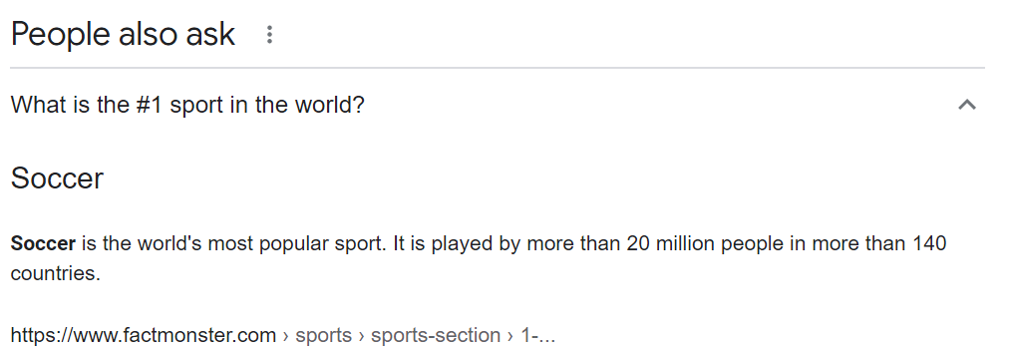
And there are about 4 billion soccer fans worldwide.

Slide 3
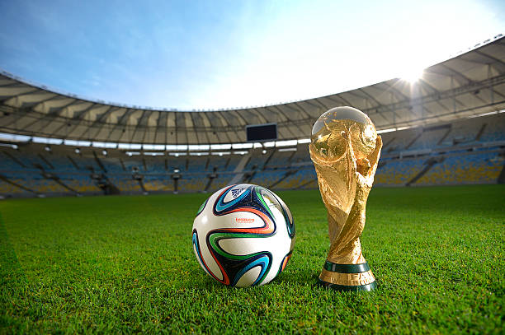
Topic:
2022 FIFA World Cup Prediction
The Trophy of FIFA World Cup

Slide 4
Facts of FIFA World Cup
FIFA: International Federation of Association Football
The most significant tournament for footballers
Be held every 4 years
Qatar, Nov. 20 – Dec. 18, 2022

Slide 5
Why is this time special?
The first time held in November (usually in June since 1930)
The first time held in a middle east country
The first time held by a host country who had never been qualified to attend before
The last time played by 32 teams (since 1998)

Slide 6
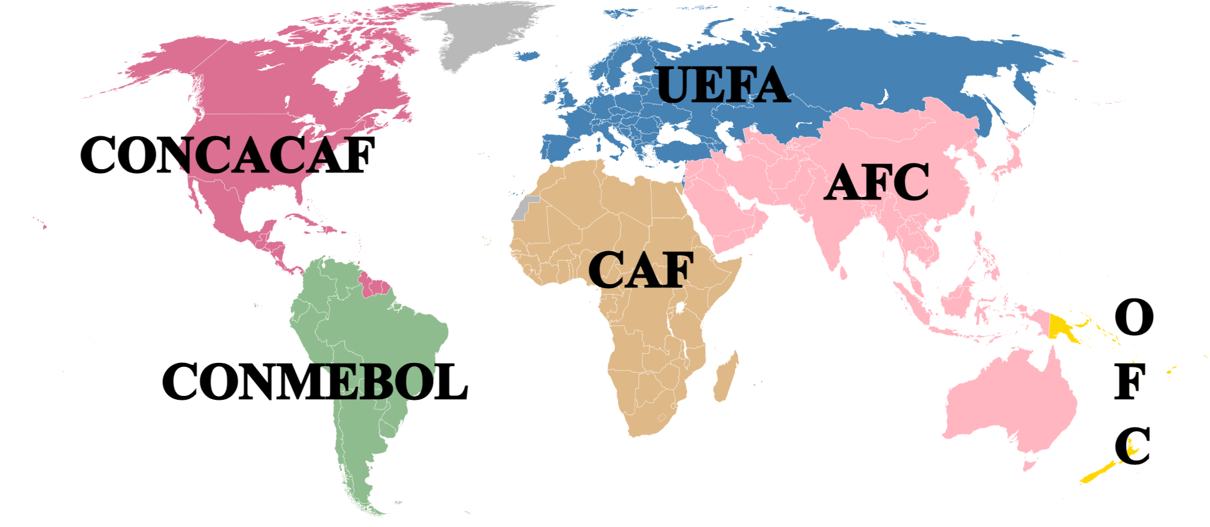
13
3.5
0.5
4.5
4.5
5
The host country is qualified directly.
The ‘0.5’ spots will be extra matches.

Slide 7
1/8 final
A
Qatar, Ecuador, Senegal, Netherlands
E
Spain, Costa Rica, Germany, Japan
T1
A1 v. B2
T5
E1 v. F2
quarterfinal
T9
W1 v. W2
T15
L13 v. L14
T10
W5 v. W6
B
England, Iran,
USA, Wales
F
Belgium, Canada, Morocco, Croatia
T2
C1 v. D2
T6
G1 v. H2
semifinal
final
T13
W9 v. W10
T16
W13 v. W14
T14
W11 v. W12
C
Argentina, Saudi Arabia, Mexico, Poland
G
Brazil, Serbia, Switzerland, Cameroon
T3
B1 v. A2
T7
F1 v. E2
48 group games
16 ties
T11
W3 v. W4
T12
W7 v. W8
D
France, Australia, Denmark, Tunisia
H
Portugal, Ghana,
Uruguay, South Korea
T4
D1 v. C2
T8
H1 v. G2

Slide 8
What people do about this topic
Find best teams in the World Cup history: generate visualizations to find those teams who were qualified to the tournament for the most times, see who have played the most finals, semifinals, quarterfinals…
Use only past handover results of each two teams who will meet: calculate the probability of winning for each team in every single game, following the rule of how the World Cup works
Or skip the group stage, do only the prediction after

Slide 9
Outline
Use 2018 FIFA World Cup results as a test data
2 parts predictions
Group stage: 32 teams to 16 teams (8 groups each 2 in, by points)
Ties: from R16 (1/8 final) to final
Apply to 2022 predictions

Slide 10
Data Sources
International football results since 1872
FIFA world rankings since 1992
Source: www.kaggle.com

Slide 11
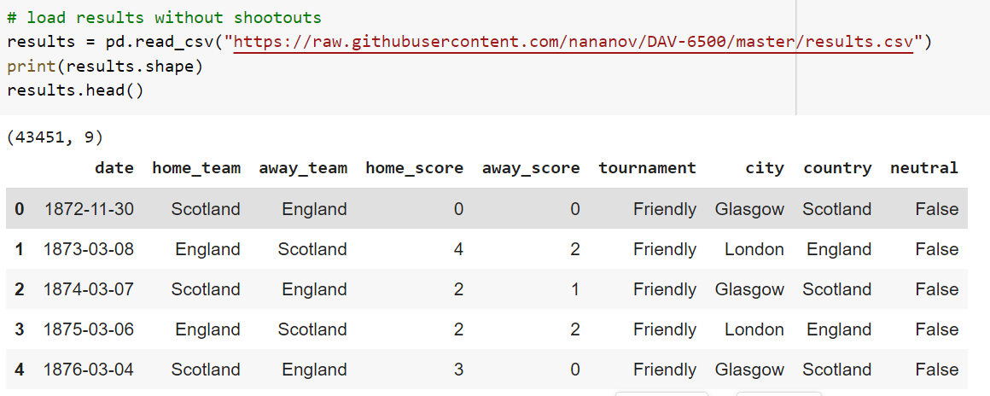

Slide 12
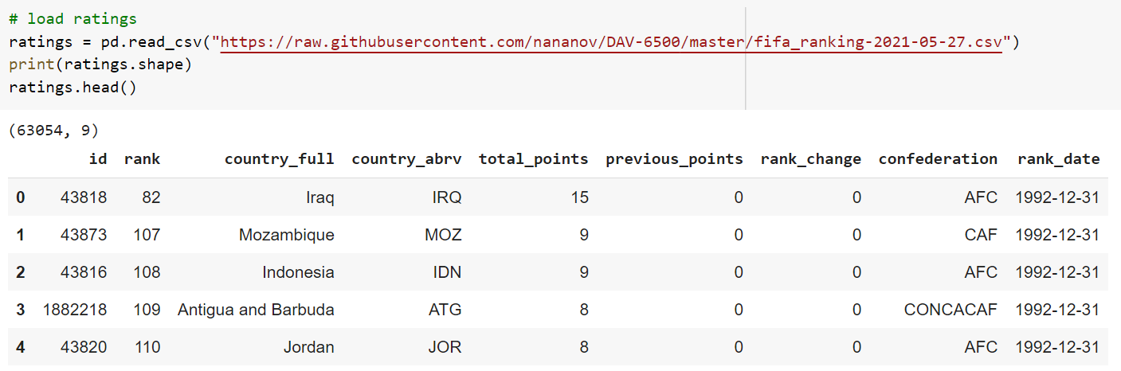

Slide 13
Group Stage Predictions
Target: either game or team
Game: predict the result of each game (3 results, win, lose or draw), calculate points earned and see who will go to next round
Team: directly predict whether a team will win from the group or not (2 results, win or not)

Slide 14
By Game Results
Calculate probability of winning for a team according to handover history
- Weights: World Cup = 50, Confederations = 40, Qualifications = 25, Friendly = 10
- Chronology: games before 1992 will be weighted half
Search for teams who have played the most games in the World Cup in each group

Slide 15
By FIFA Ratings
Build a model using data from 98-14 World Cup to learn about the relationship between a team’s performance and their features
- decision tree and logistic regression, features including FIFA ratings, confederations, groups…
Calculate probability of winning for a team using FIFA official expectation formula: We = 1 / [10^(-dr/600) +1], dr is the difference of points
Search for teams who ranked first and second highest in each group

Slide 16
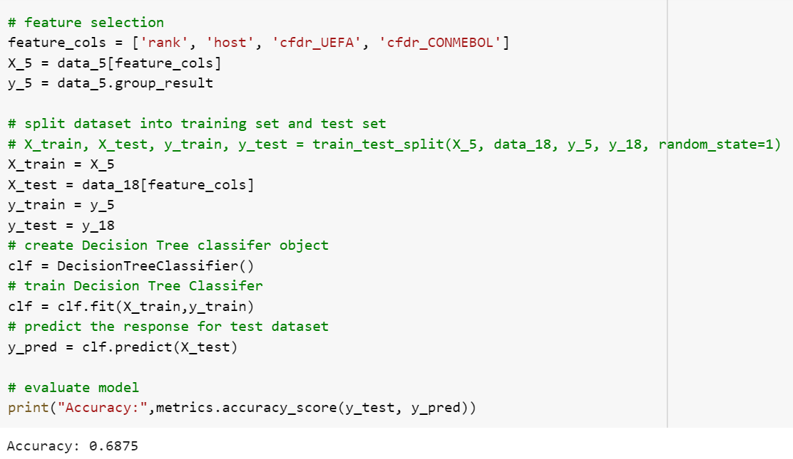

Slide 17
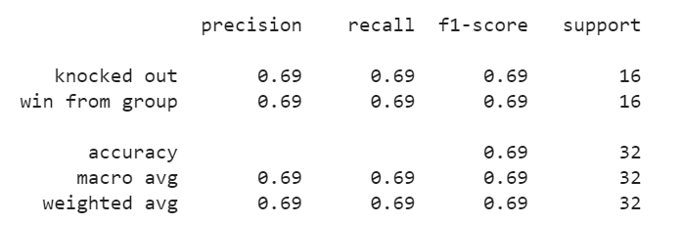
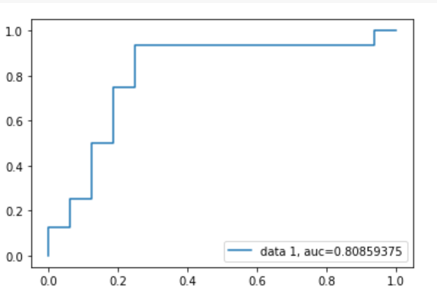
Train: 98-14
Test: 18
Cols: rank, host, 2 confederation dummies
Accuracy: 22/32 (11/16)

Slide 18
Dataset | Method | Target | Correct # | Accuracy | By group
Game results | Calculate probabilities | game | 10/16 | 0.6 | yes
Game results | Search for most experienced teams | team | 11/16 | 0.6875 | yes
FIFA ratings | Build a regression model | team | 11/16 | 0.6875 | no
FIFA ratings | Calculate probabilities | game | 11/16 | 0.6875 | yes
FIFA ratings | Search for top ranked teams | team | 12/16 | 0.75 | yes
Picking 2 teams ranked higher from each group turns to be the most accurate and efficient way.
Results are strictly classified by groups.
The most accurately predicted teams will be used for next part.

Slide 19
A
Russia, Saudi Arabia, Egypt, Uruguay
0.644
0.588
E
Costa Rica, Serbia, Brazil, Switzerland
Uruguay
Egypt
Brazil
Switzerland
0.364
0.463
B
Morocco, IR Iran, Portugal, Spain
0.519
0.820
F
Germany, Mexico, Sweden, South Korea
Portugal
Spain
Germany
Mexico
0.449
0.459
0.313
0.554
C
France, Australia, Peru, Denmark
G
Belgium, Panama, Tunisia, England
France
Peru
Belgium
England
0.269
0.393
D
Argentina, Iceland, Croatia, Nigeria
0.542
0.498
H
Colombia, Japan, Poland, Senegal
Argentina
Croatia
Poland
Colombia
0.315
0.372
* Red letters are predicted wrong

Slide 20
Knock-out Predictions
With ratings: calculate probability of winning for a team using FIFA official expectation formula
With game results: calculate probability of winning for a team according to handover history
Accuracy check: see how many teams can match to the real advancing procedure diagram

Slide 21
Uruguay
0.270
Predict by Ratings
0.476
Portugal
Spain
Portugal
Spain
0.129
0.253
Egypt
France
0.245
Portugal
France
Argentina
Germany
France
Argentina
Croatia
Peru
0.227
0.330
Brazil
Germany
Brazil
0.497
0.655
Germany
0.221
0.396
Brazil
Germany
Mexico
Switzerland
Brazil
16/31 spots right
0.516 accuracy
Germany
Belgium
Poland
Belgium
0.311
0.529
Poland
Columbia
England
0.425
0.311
* Red letters are predicted wrong

Slide 22
Uruguay
0.385
Predict by Results
0.519
Portugal
Spain
Portugal
Spain
0.118
0.288
Egypt
France
0.0399
Argentina
France
Argentina
France
France
Argentina
Croatia
Peru
0.223
0.384
France
England
Brazil
0.341
0.615
Germany
0.0708
0.127
Brazil
Germany
Mexico
Switzerland
Belgium
21/31 spots right
0.677 accuracy
England
Belgium
Poland
Belgium
0.312
0.191
England
Columbia
England
0.416
0.286
* Red letters are predicted wrong

Slide 23
2022 Predictions
According to the results check, apply the most accurate prediction method from each part to the game of 2022

Slide 24
A
Qatar, Ecuador, Senegal, Netherlands
0.311
0.251
E
Spain, Costa Rica, Germany, Japan
Netherlands
Senegal
Spain
Germany
0.235
0.210
B
England, Iran,
USA, Wales
0.252
0.376
F
Belgium, Canada, Morocco, Croatia
England
USA
Belgium
Croatia
0.185
0.251
0.343
0.412
C
Argentina, Saudi Arabia, Mexico, Poland
G
Brazil, Serbia, Switzerland, Cameroon
Argentina
Mexico
Brazil
Switzerland
0.253
0.255
D
France, Australia, Denmark, Tunisia
0.315
0.255
H
Portugal, Ghana,
Uruguay, South Korea
France
Denmark
Portugal
Uruguay
0.253
0.233

Slide 25
Netherlands
0.249
Predicted by Results
0.160
England
Netherlands
England
USA
0.172
0.0970
Senegal
Netherlands
0.0454
France
Argentina
France
Netherlands
Denmark
France
Denmark
Mexico
0.202
0.172
Netherlands
France
Spain
0.195
0.210
Belgium
0.0956
0.0576
Spain
Germany
Croatia
Germany
Brazil
Germany
Brazil
Portugal
Brazil
0.152
0.149
Portugal
Uruguay
Switzerland
0.190
* The final will be at this weekend.
0.144

Slide 26
Frustrations & Improvements
Large datasets but few can be used to build models
Spent months on logistic regression
Too many upsets during the tournament
Try ranking algorithms

Slide 27
Related Research Papers
A machine learning framework for sport result prediction, Applied Computing and Informatics, Volume 15, Issue 1, 2019
A neural network method for prediction of 2006 World Cup Football Game, International Joint Conference on Neural Networks, 2010
Prediction of the FIFA World Cup 2018 - A random forest approach with an emphasis on estimated team ability parameters, 2018
Brazil or Germany - who will win the trophy? Prediction of the FIFA World Cup 2014 based on team-specific regularized Poisson regression, 2014

Slide 28
Useful websites
https://www.eloratings.net/
https://www.fifa.com/fifa-world-ranking/men
https://www.national-football-teams.com/
https://www.transfermarkt.com/

Slide 29
Reference
https://cxl.com/blog/bayesian-frequentist-ab-testing/
https://www.datacamp.com/tutorial/decision-tree-classification-python
https://www.datacamp.com/tutorial/understanding-logistic-regression-python
https://livematchupdates.com/football-news/what-is-the-best-algorithm-for-football-match-score-predictions/
https://neptune.ai/blog/keras-loss-functions
https://towardsdatascience.com/machine-learning-for-sports-betting-not-a-basic-classification-problem-b42ae4900782
https://www.telegraph.co.uk/world-cup/how-to-predict-a-world-cup-winner/

